Slide 1
Lab 5

Slide 2
Purpose
To demonstrate knowledge of
File IO
(log4j) Logging

Slide 3
File I/O
Read the items from a file instead of passing them in on the commandline
the input file must be named customerss.txt
Output the Customers Report to a file named customers_report.txt
Note! Your jar file will run with no commandline arguments as it will be using a default file name (customers.txt) as input

Slide 4
Logging
Replace any System.out.println statements – except the usage message - with appropriate level logging statements
Use the 'configureLogging()' method that we used in the lecture to configure the logging

Slide 5
Exceptions
All exceptions must be logged at error level
If customers.txt doesn’t exist, print an error message to the console and to the log file and exit
Ensure you are handling any other exceptions
Make sure you’ve closed any open resources

Slide 6
Note
The lab input file was edited on a unix-based system which has a different line terminator than windows. If the file is opened in notepad++ it should look 'normal'. Scanner and other file input objects are able to figure out the line terminator.
Once you've finished debugging your program in eclipse, make sure you copy log_config.xml and customers.txt to your 'out' folder and test your jar!

Slide 7
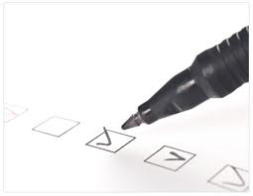
Checklist
I have:
Met all the functional requirements
Followed the java coding conventions
Used a file template to add my name & student number to all source files
Used packages; the root package is my student number, ex. package a00123456…;
Used great object-oriented design
Run “Source > Format” on my project
Included all source code & required resources
Created a runnable Jar file for testing
Zipped up all my files into a single file named <your student number>.zip, ex. A00123456.zip
Submitted my lab before the due date & time

